Slide 1

SCHOOL of COMPUTING DEPARTMENT of COMPUTER SCIENCE & ENGINEERING
COURSE CATEGORY :PROGRAM CORE
COURSE NAME:DATA WAREHOUSING AND DATA MINING
COURSE CODE:1151CS114
FACULTY: Dr. CARMEL MARY BELINDA M J

Slide 2
Course Outcomes
CO Nos. | Course Outcomes | K Level
CO1 | Explain and identify the subject areas for which a data warehouse is to be built. | K2
CO2 | Design Multidimensional data model for data warehouse and analyze the market needs by applying the suitable OLAP operations. | K3
CO3 | Explain the concept of Data mining system and apply the various preprocessing techniques on large dataset. | K2
CO4 | Apply Association rule mining, classification and clustering techniques to discover various mining patterns. | K3
CO5 | Apply clustering techniques in various data mining applications | K3

Slide 3
UNIT III Data Mining
TOPICS COVERED
Introduction to Data mining and Knowledge Discovery
Data and Databases
Data Mining Functionalities
Steps in Data Mining Process
Architecture of Typical Data Mining systems
Classification of Data Mining Systems
Data Mining Task Primitives
Overview of Data mining Techniques
Issues
Data Preprocessing

Slide 4
History of Data Mining
Early techniques of identifying patterns in data include Bayes theorem (1700s).
Evolution of regression(1800s)
Neural networks, clustering, genetic algorithms (1950s)
Decision trees(1960s)
Supporting vector machines (1990s)
In 1990s, the term "Data Mining" was introduced.

Slide 5
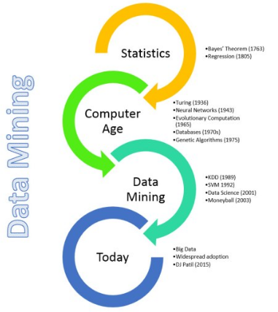
History of Data Mining

Slide 6
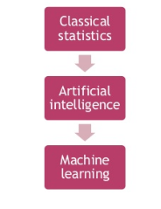
Origin of Data Mining
Data mining origins are traced back to three family lines:
Classical statistics
Artificial Intelligence
Machine Learning

Slide 7
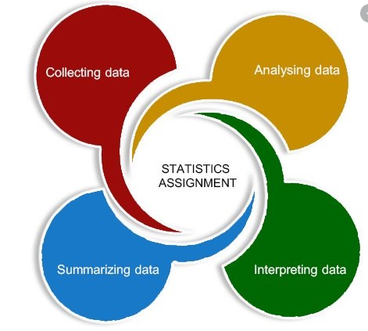
Origin of Data Mining
Classical statistics
Statistics are the basis of most technology on which data mining is built, such as regression analysis, standard deviation, standard distribution, standard variance, discriminatory analysis, cluster analysis, and confidence intervals.
All of these are used to analyze data and data connection.

Slide 8

Origin of Data Mining
Artificial Intelligence
AI or Artificial intelligence is based on heuristics as opposed to statistics. It tries to apply human- thought like processing to statistical problems.
A specific AI concept was adopted by some high-end commercial products, such as query optimization modules for Relational Database Management System(RDBMS).

Slide 9

Origin of Data Mining
Machine Learning
Machine learning is a combination of statistics and AI.
It might be considered as an evolution of AI because it mixes AI heuristics with complex statistical analysis.
It uses statistics for basic concepts and adding more AI heuristics and algorithms to accomplish its target.

Slide 10
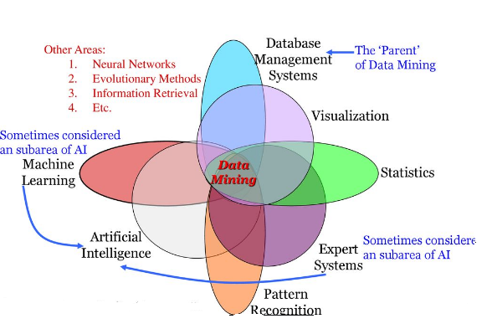
Data Mining Related Areas

Slide 11
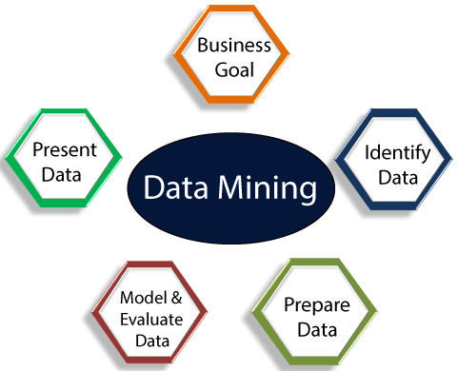
Data mining
The process of extracting information to identify patterns, trends, and useful data that would allow the business to take the data-driven decision from huge sets of data.
Data Mining is also called Knowledge Discovery of Data (KDD).

Slide 12
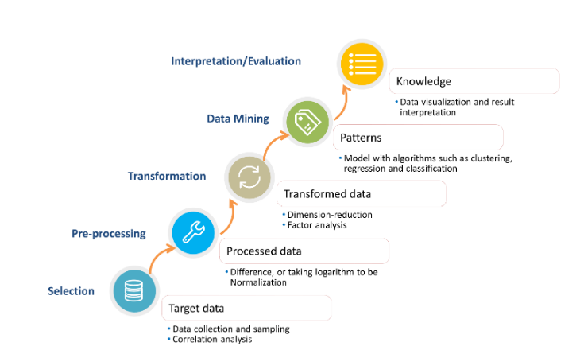
KDD- Knowledge Discovery in Databases
The main objective of the KDD process is to extract information from data in the context of large databases
The process begins with determining the KDD objectives and ends with the implementation of the discovered knowledge.

Slide 13

Types of Data
Relational databases
Data warehouses
Advanced DB and information repositories
Object-oriented and object-relational databases
Transactional and Spatial databases
Multimedia database
Text databases
Text mining and Web mining

Slide 14
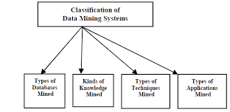
Classification of Data Mining Systems
Data mining systems can be categorized according to various criteria,
Classification according to the application adapted
Classification according to the type of techniques utilized
Classification according to the types of knowledge mined
Classification according to types of databases mined

Slide 15
Data Mining Functionalities
Concept/Class Description: Characterization and Discrimination
Mining Frequent Patterns, Associations, and Correlations
Classification and Prediction
Cluster Analysis
Outlier Analysis

Slide 16
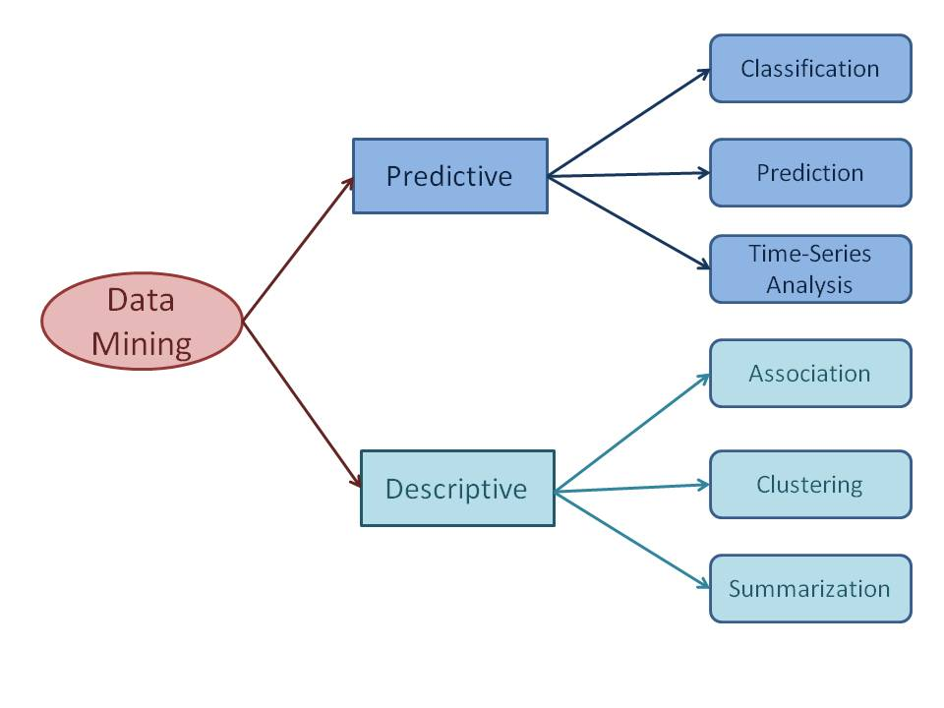
Data Mining Functionalities

Slide 17
Data Mining Functionalities
Data mining functionalities are used to specify the kind of patterns to be found in data mining tasks. Data mining tasks can be classified into two categories:
Descriptive
Descriptive mining tasks characterize the general properties of the data in the database
Predictive.
Predictive mining tasks perform inference on the current data in order to make predictions.

Slide 18
Concept/Class Description: Characterization and Discrimination
Data can be associated with classes or concepts.
Electronics store, classes of items for sale include computers and printers,
concepts of customers include bigSpenders and budgetSpenders.
Data characterization
Data characterization is a summarization of the general characteristics or features of a target class of data.
Data discrimination
Data discrimination is a comparison of the general features of target class data objects with the general features of objects from one or a set of contrasting classes.

Slide 19
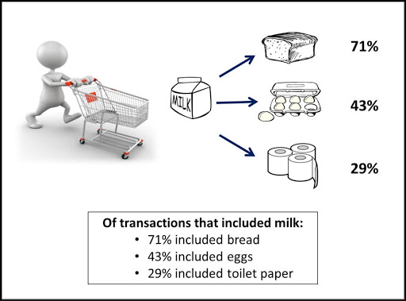

Mining Frequent Patterns, Associations, and Correlations
Association analysis
Suppose, as a marketing manager, you would like to determine which items are frequently purchased together within the same transactions.
buys(X,“computer”)=buys(X,“software”) [support=1%,confidence=50%]

Slide 20
Mining Frequent Patterns, Associations, and Correlations
where X is a variable representing a customer. Confidence=50% means that if a customer buys a computer, there is a 50% chance that she will buy software as well.
Support=1% means that 1% of all of the transactions under analysis showed that computer and software were purchased together.

Slide 21
Data Mining Functionalities
Association Rules:
Association rules are if-then statements that support to show the probability of interactions between data items within large data sets in different types of databases.
These are three major measurements technique
Lift: This measurement technique measures the accuracy of the confidence over how often item B is purchased. (Confidence) / (item B)/ (Entire dataset)

Slide 22
Data Mining Functionalities
Support: This measurement technique measures how often multiple items are purchased and compared it to the overall dataset. (Item A + Item B) / (Entire dataset)
Confidence: This measurement technique measures how often item B is purchased when item A is purchased as well. (Item A + Item B)/ (Item A)

Slide 23
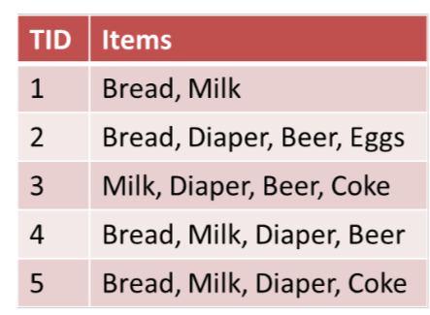
Market basket Analysis

Slide 24
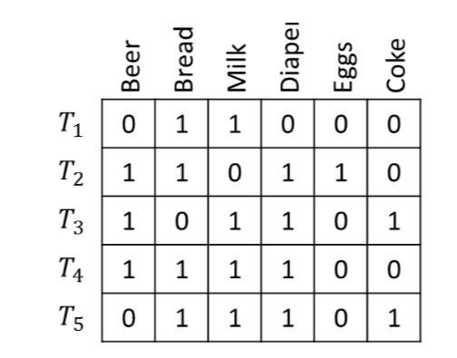
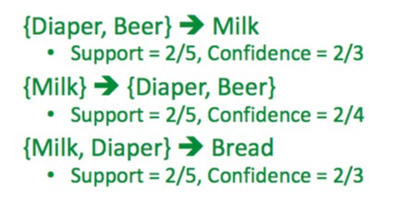

Slide 25
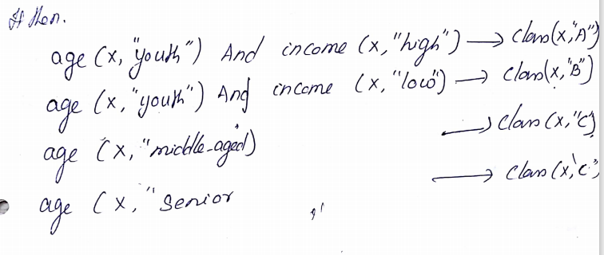
Classification and Prediction
Classification is the process of finding a model that describes and distinguishes data classes for the purpose of being able to use the model to predict the class of objects whose class label is unknown.
The derived model may be represented in various forms, such as classification (IF-THEN) rules, decision trees, mathematical formulae, or neural networks

Slide 26
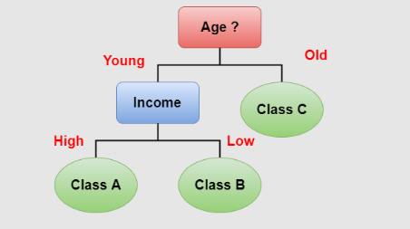
Classification and Prediction
A decision tree is a flow-chart-like tree structure, where each node denotes a test on an attribute value, each branch represents an outcome of the test, and tree leaves represent classes or class distributions.

Slide 27
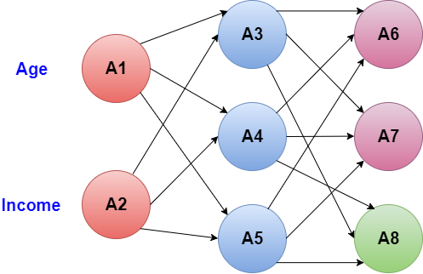
Classification and Prediction
A neural network, when used for classification, is typically a collection of neuron-like processing units with weighted connections between the units.

Slide 28
Prediction
Prediction deals with some variables or fields, which are available in the data set to predict unknown values regarding other variables of interest.
Numeric prediction is the type of predicting continuous or ordered values for given input.
For example: The company may wish to predict the potential sales of a new product given with its price.
The most widely used approach for numeric prediction is regression.

Slide 29
Classification vs Prediction
Classification | Prediction
It uses the prediction to predict the class labels. | It is used to assess the values of an attribute of a given sample.
For example: If the patients are grouped on the basis of their known medical data and treatment outcome, then it is considered as classification. | For example: If a classification model is used to predict the treatment outcome for a new patient, then it is prediction.

Slide 30
Issues related to Classification and Prediction
1.Data preparation Data preparation consist of data cleaning, relevance analysis and data transformation.
2. Evaluation of classification methods
i) Predictive accuracy: This is an ability of a model to predict the class label of a new or previously unseen data.
ii) Speed and scalability: It refers to the time required to construct and use the model and increase efficiency in disk- resident databases. 3. Inter-predictability: It is an understanding and insight provided by the model.

Slide 31
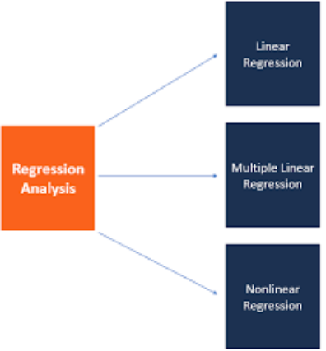
Data Mining Functionalities
Regression
Regression analysis is the data mining process is used to identify and analyze the relationship between variables because of the presence of the other factor.
Regression involves predictor variable (the values which are known) and response variable (values to be predicted).

Slide 32
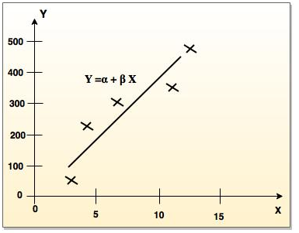
Types of regression
The two basic types of regression are:
Linear regression
Multiple regression model

Slide 33
Linear regression
Linear regression attempts to model the relationship between two variables by fitting a linear equation to observe the data.
Linear regression attempts to find the mathematical relationship between variables.
If outcome is straight line then it is considered as linear model and if it is curved line, then it is a non linear model.
The relationship between dependent variable is given by straight line and it has only one independent variable. Y = α + Β X
Model 'Y', is a linear function of 'X'.
The value of 'Y' increases or decreases in linear manner according to which the value of 'X' also changes.

Slide 34
Multiple regression model
Multiple linear regression is an extension of linear regression analysis.
It uses two or more independent variables to predict an outcome and a single continuous dependent variable. Y = a₀ + a₁ X₁ + a₂ X₂ +.........+a_{k} X_{k} +e where, 'Y' is the response variable. X₁ + X₂ + X_{k} are the independent predictors. 'e' is random error. a₀, a₁, a₂, a_{k} are the regression coefficients.

Slide 35
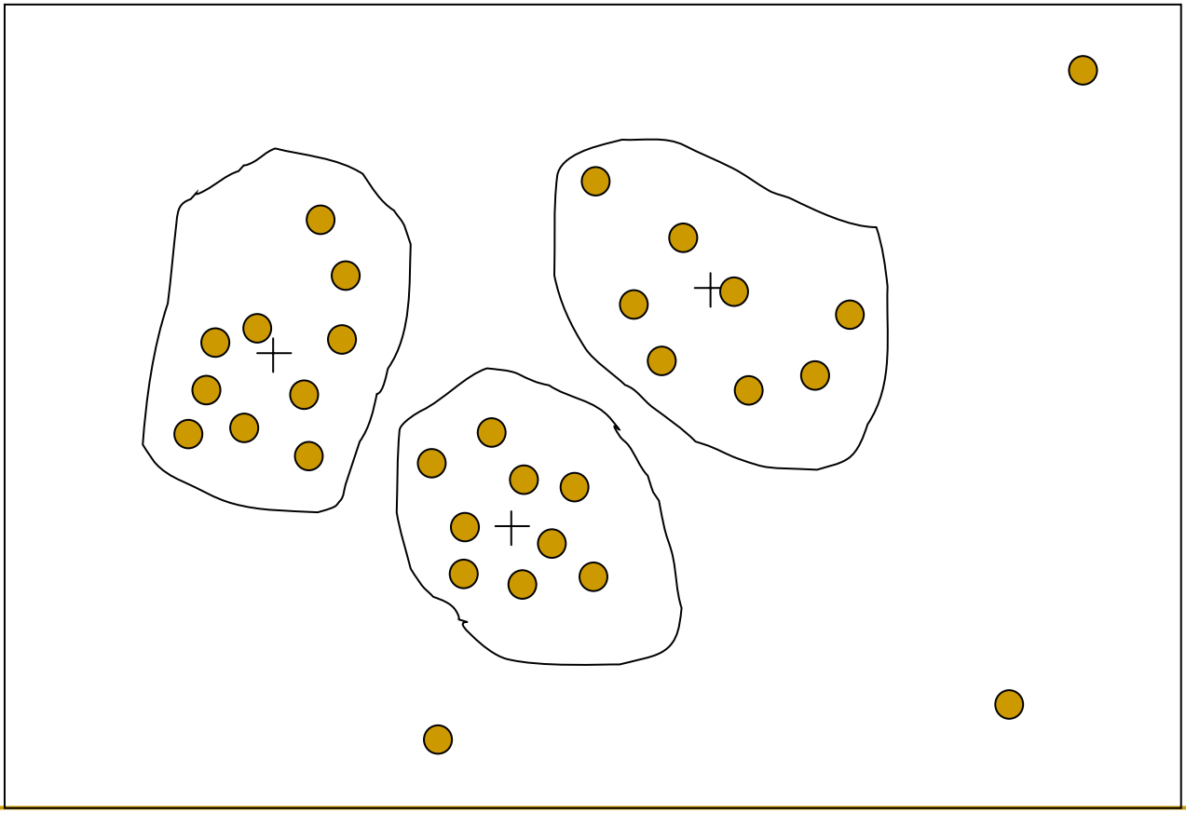
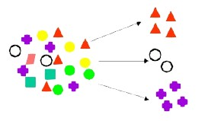
Cluster Analysis
Grouping of Objects
objects within a cluster have high similarity in comparison to one another, but are very dissimilar to objects in other clusters.

Slide 36

Outlier Analysis
A database may contain data objects that do not comply with the general behavior or model of the data. These data objects are outliers.

Slide 37
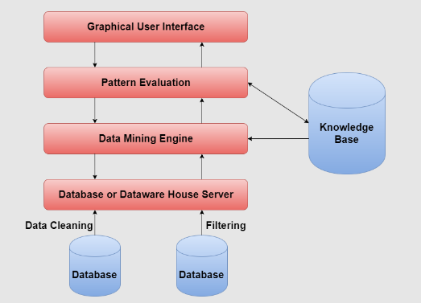
Architecture of Typical Data Mining systems

Slide 38
Architecture of Typical Data Mining systems
Data Warehouse:
A data warehouse is a place which store information collected from multiple sources under unified schema.
Information stored in a data warehouse is critical to organizations for the process of decision-making.
Data Mining Engine:
Data Mining Engine is the core component of data mining process which consists of various modules that are used to perform various tasks like clustering, classification, prediction and correlation analysis.
Pattern Evaluation:
Pattern Evaluation is responsible for finding various patterns with the help of Data Mining Engine.

Slide 39
Architecture of Typical Data Mining systems
User Interface:
User Interface provides communication between user and data mining system.
It allows user to use the system easily even if user doesn't have proper knowledge of the system.
Knowledge Base:
Knowledge Base consists of data that is very important in the process of data mining.
Knowledge Base provides input to the data mining engine which guides data mining engine in the process of pattern search.

Slide 40
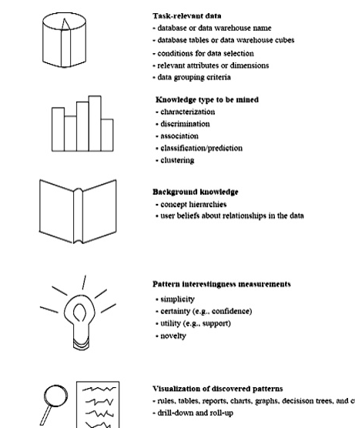
Data Mining Task Primitives

Slide 41
A data mining query
A data mining query language can be designed to incorporate these primitives, allowing users to flexibly interact with data mining systems. Having a data mining query language provides a foundation on which user-friendly graphical interfaces can be built

Slide 42
Example
Suppose, as a marketing manager of AllElectronics, you would like to classify customers based on their buying patterns. You are especially interested in those customers whose salary is no less than $40,000, and who have bought more than $1,000 worth of items, each of which is priced at no less than $100. In particular, you are interested in the customer’s age, income, the types of items purchased, the purchase location, and where the items were made. You would like to view the resulting classification in the form of rules. This data mining query is expressed in DMQL
(1) use database AllElectronics db (2) use hierarchy location hierarchy for T.branch, age hierarchy for C.age (3) mine classification as promising customers (4) in relevance to C.age, C.income, I.type, I.place made, T.branch (5) from customer C, item I, transaction T (6) where I.item ID = T.item ID and C.cust ID = T.cust ID and C.income ≥ 40,000 and I.price ≥ 100 (7) group by T.cust ID

Slide 43
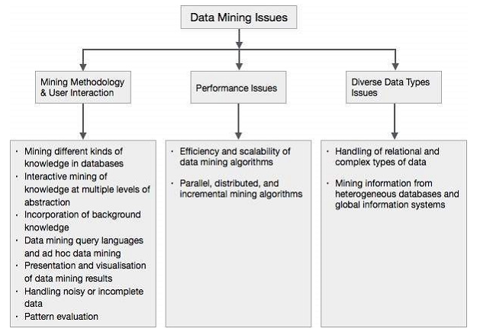
Data Mining Issues

Slide 44
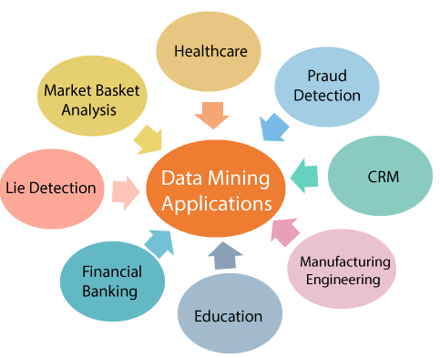
Data Mining Applications

Slide 45
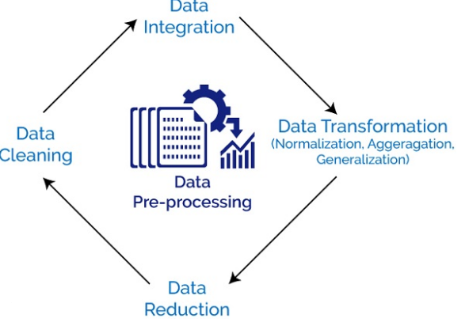
DATA PREPROCESSING
Data preprocessing is a data mining technique that involves transforming raw data into an understandable format.

Slide 46
Why Preprocess the Data?
Accuracy
Completeness
Consistency
Timeliness
Believability
Interpretability

Slide 47
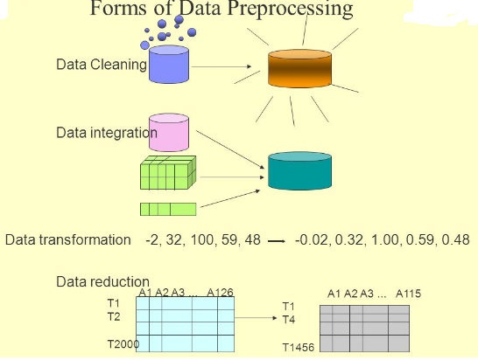
Steps Involved in Data Preprocessing

Slide 48
DATA CLEANING
Missing Values
Ignore the tuple-when the class label is missing
Fill in the missing value manually-this approach is time consuming and may not be feasible given a large data set with many missing values.
Use a global constant to fill in the missing value-Replace all missing attribute values by the same constant such as a label like “Unknown” or −∞.
Use a measure of central tendency for the attribute to fill in the missing value-the mean or median
Use the attribute mean or median for all samples belonging to the same class as the given tuple
Use the most probable value to fill in the missing value-This may be determined with regression, inference-based tools using a Bayesian formalism, or decision tree.

Slide 49
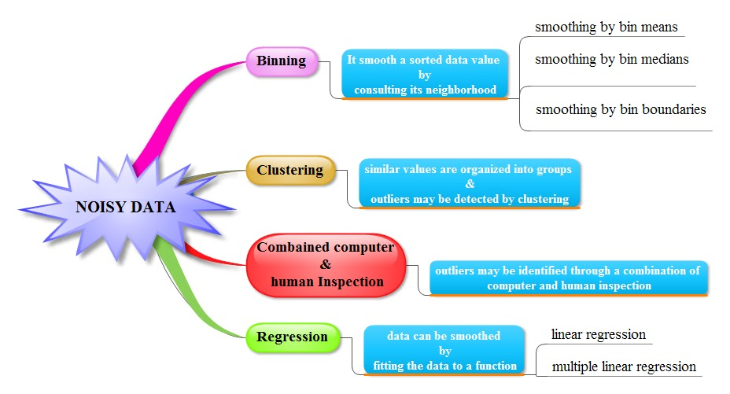
How to Clean Noisy Data
Missing Values
Ignore the tuple
Fill in the missing value manually
Use a global constant to fill in the missing value
Use a measure of central tendency for the attribute to fill in the missing value
Use the attribute mean or median for all samples belonging to the same class as the given tuple
Use the most probable value to fill in the missing value

Slide 50
DATA CLEANING
Noisy Data
Binning: Binning methods smooth a sorted data value by consulting its “neighbourhood.
Steps:
The data are first sorted and then partitioned into equal-frequency bins
Smoothing By Bin Means- each value in a bin is replaced by the mean value of the bin.
Smoothing By Bin Medians- in which each bin value is replaced by the bin median.
Smoothing By Bin Boundaries- the minimum and maximum values in a given bin are identified as the bin boundaries. Each bin value is then replaced by the closest boundary value.

Slide 51
How to Clean Noisy Data
GIVEN A SET OF VALUES: 4, 8, 9, 21, 15, 25, 21, 24, 29, 34,26, 28, Use smoothing methods to smooth the datas
Sorted data for price (in dollars): 4, 8, 9, 15, 21, 21, 24, 25, 26, 28, 29, 34
Smoothing by bin means:
- Bin 1: 9, 9, 9, 9
- Bin 2: 23, 23, 23, 23
- Bin 3: 29, 29, 29, 29
Smoothing by bin median:
- Bin 1: 9 9, 9, 9
- Bin 2: 24, 24, 24, 24
- Bin 3: 29, 29, 29, 29
Smoothing by bin boundaries:
- Bin 1: 4, 4, 4, 15
- Bin 2: 21, 21, 25, 25
- Bin 3: 26, 26, 26, 34

Slide 52
Example for Binning methods
For the attribute age: 13, 15, 19, 16, 16, 20, 20, 21, 22, 22, 25, 25, 25, 25, 35, 30, 33, 33, 35, 35, 45, 35, 36, 52, 40, 46, 70.
Use smoothing by bin means, median, boundary to smooth these data, using a bin depth of 3.

Slide 53
Example for Binning methods
Suppose a group of 12 sales price records has been sorted as follows: 5, 15, 10, 50, 11, 13, 35, 204, 55, 72, 215, 92. Use smoothing by bin means, median, boundary to smooth these data, using a equal bin depth.

Slide 54
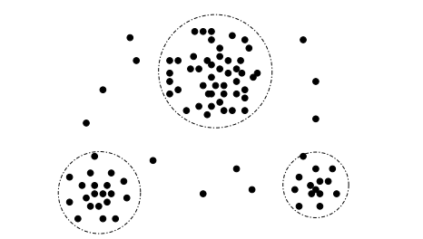
Cluster Analysis
A 2-D customer data plot with respect to customer locations in a city, showing three data clusters. Outliers may be detected as values that fall outside of the cluster sets.

Slide 55
Regression
y
Y1
Y1’
y = x + 1
X1
x
Linear regression (best line to fit
two variables)
Multiple linear regression (more
than two variables, fit to a
multidimensional surface

Slide 56
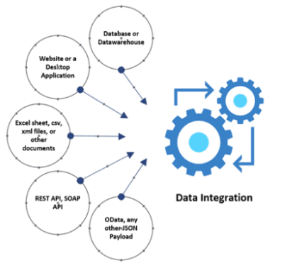
Data Integration

Slide 57
Data Integration
Data integration:
combines data from multiple sources into a coherent store
Entity Identification Problem
Redundancy and Correlation Analysis
Tuple Duplication
Data Value Conflict Detection and Resolution

Slide 58
Data Integration
Redundancy and Correlation Analysis.
An attribute may be redundant if it can be “derived” from another attribute or set of attributes.
redundancies can be detected by correlation analysis.
Given two attributes, such analysis can measure how strongly one attribute implies the other, based on the available data.
For nominal data, we use the χ 2 (chi-square) test.
For numeric attributes, we can use the correlation coefficient and covariance.

Slide 59

χ 2 Correlation Test for Nominal Data
For nominal data, a correlation relationship between two attributes, A and B, can be discovered by a χ 2 (chi-square) test.
Suppose A has c distinct values, namely a1,a2,...ac .
B has r distinct values, namely b1,b2,...br .
The data tuples described by A and B can be shown as a contingency table, with the c values of A making up the columns and the r values of B making up the rows.
Let (Ai ,Bj) denote the joint event that attribute A takes on value ai and attribute B takes on value bj , that is, where (A = ai ,B = bj).
Each and every possible (Ai ,Bj) joint event has its own cell (or slot) in the table. The χ 2 value (also known as the Pearson χ 2 statistic) is computed as

Slide 60

χ 2 Correlation Test for Nominal Data
where o_{ij} is the observed frequency (i.e., actual count) of the joint event (Ai ,Bj) and e_{ij}is the expected frequency of (Ai ,Bj), which can be computed as
where n is the number of data tuples, count(A = ai) is the number of tuples having value ai for A, and count(B = bj) is the number of tuples having value bj for B

Slide 61
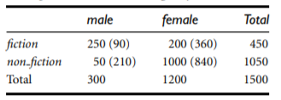
Example
Suppose that a group of 1500 people was surveyed. The gender of each person was noted. Each person was polled as to whether his or her preferred type of reading material was fiction or nonfiction. Thus, we have two attributes, gender and preferred reading. The observed frequency (or count) of each possible joint event is summarized in the contingency table shown in Table below

Slide 62
Example
e11 = count(male) × count(fiction)/n =
(300 × 450) /1500 = 90
e12 = count(female) × count(fiction)/n=
(1200 × 450) /1500 = 360.
e21 = count(male) × count(non-fiction)/n =
(300 × 1050) /1500 = 210
e22 = count(female) × count(non-fiction)/n=
(1200 × 1050) /1500 = 840.

Slide 63
Example
χ 2 is computed as
χ 2 = (250 − 90) ² /90 + (50 − 210) ² /210 + (200 − 360) ² /360 + (1000 − 840) ² /840
= 284.44 + 121.90 + 71.11 + 30.48
= 507.93.

Slide 64
Example
A group of students were classified in terms of personality (introvert or extrovert) and in terms of colour preference (red, yellow, green or blue) with the purpose of seeing whether there is an association (relationship) between personality and colour preference. Data was collected from 400 students and presented in the 2 (rows) x 4 (cols) contingency table below: calculate Correlation Test for Nominal Data
(Observed counts) | Colours
 | Red | Yellow | Green | Blue | Totals
Introvert personality | 20 | 6 | 30 | 44 | 100
Extrovert personality | 180 | 34 | 50 | 36 | 300
Totals | 200 | 40 | 80 | 80 | 400

Slide 65
Example
(Expected counts) | Colours
 | Red | Yellow | Green | Blue
Introvert personality | 50 | 10 | 20 | 20
Extrovert personality | 150 | 30 | 60 | 60
Totals | 200 | 40 | 80 | 80

Slide 66
χ 2 = (20 − 50) ² /50 + (180 − 150) ² /150 + (6 − 10) ² /10 + (34− 30) ² /30+ (30− 20) ² /20+ (50− 60) ² /60+ (44− 20) ² /20+ (36− 60) ² /60
χ 2 =18+1.6+5+28.8+6+1.7+9.6+0.5=71.2

Slide 67

Correlation Coefficient for Numeric Data:
For numeric attributes, we can evaluate the correlation between two attributes, A and B, by computing the correlation coefficient (also known as Pearson’s product moment coefficient).
This is given as
where n is the number of tuples, ai and bi are the respective values of A and B in tuple i, A¯ and B¯ are the respective mean values of A and B, σA and σB are the respective standard deviations of A and B.
- is the sum of the AB cross-product

Slide 68
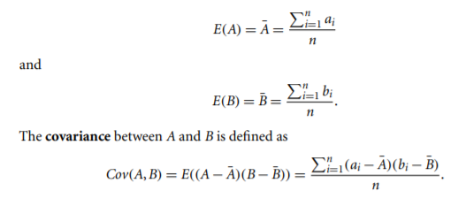
Covariance of Numeric Data
correlation and covariance are two similar measures for assessing how much two attributes change together. Consider two numeric attributes A and B, and a set of n observations {(a1,b1),...,(an,bn)}. The mean values of A and B, respectively, are also known as the expected values on A and B, that is,

Slide 69


Covariance of Numeric Data
If we compare Eq for rA,B (correlation coefficient) with Eq. for covariance,
where σA and σB are the standard deviations of A and B, respectively

Slide 70
Covariance of Numeric Data
For two attributes A and B that tend to change together, if A is larger than A¯ (the expected value of A), then B is likely to be larger than B¯ (the expected value of B). Therefore, the covariance between A and B is positive.
On the other hand, if one of the attributes tends to be above its expected value when the other attribute is below its expected value, then the covariance of A and B is negative.
If A and B are independent (i.e., they do not have correlation), then E(A · B) = E(A)· E(B). Therefore, the covariance is Cov(A,B) = E(A · B) − A¯ B¯ = E(A)· E(B) − A¯ B¯ = 0.

Slide 71
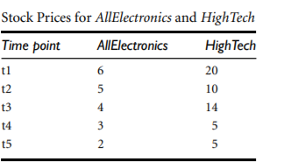
Example
Covariance analysis of numeric attributes
which presents a simplified example of stock prices observed at five time points for All Electronics and HighTech company.

Slide 72
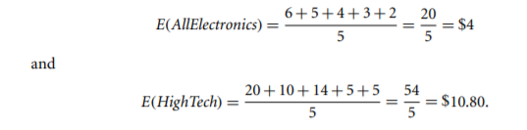

Example

Slide 73
Example
Using the data for age and body fat given. Calculate Covariance analysis of numeric attributes
1086.94-1000.4=86.54
Sl.no | Age | Fat percentage
1 | 23 | 9.5
2 | 27 | 7.8
3 | 39 | 31.4
4 | 41 | 25.9
5 | 47 | 27.4
6 | 49 | 27.2
7 | 50 | 31.2
8 | 52 | 34.6

Slide 74
Tuple Duplication & Data Value Conflict Detection and Resolution
Tuple Duplication
Detection of duplication of tuple .
Two or more identical tuples for a given unique data.
Data Value Conflict Detection and Resolution
Data integration also involves the detection and resolution of data value conflicts.
For example, for the same real-world entity, attribute values from different sources may differ. This may be due to differences in representation, scaling, or encoding. For instance, a weight attribute may be stored in metric units in one system and British imperial units in another

Slide 75
Data Reduction
Data reduction strategies include dimensionality reduction, numerosity reduction, and data compression.
Dimensionality reduction is the process of reducing the number of random variables or attributes under consideration.
Dimensionality reduction methods include wavelet transforms and principal components analysis which transform or project the original data onto a smaller space. Attribute subset selection is a method of dimensionality reduction in which irrelevant, weakly relevant, or redundant attributes or dimensions are detected and removed

Slide 76
Data Reduction
Numerosity reduction techniques replace the original data volume by alternative, smaller forms of data representation. These techniques may be parametric or nonparametric.
Parametric methods- a model is used to estimate the data, so that typically only the data parameters need to be stored, instead of the actual data. Regression and log-linear models are the examples.
Nonparametric methods for storing reduced representations of the data include histograms, clustering, sampling and data cube aggregation.

Slide 77
Data Reduction
Data compression-transformations are applied so as to obtain a reduced or “compressed” representation of the original data.
If the original data can be reconstructed from the compressed data without any information loss, the data reduction is called lossless.
If, instead, we can reconstruct only an approximation of the original data, then the data reduction is called lossy.

Slide 78
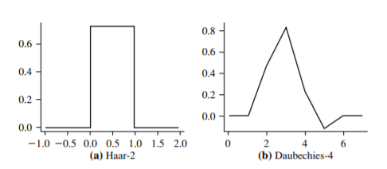
Data Reduction
Wavelet Transforms
The discrete wavelet transform (DWT) is a linear signal processing technique that, when applied to a data vector X, transforms it to a numerically different vector, X¹ , of wavelet coefficients.
The two vectors are of the same length. When applying this technique to data reduction, we consider each tuple as an n-dimensional data vector, that is, X = (x₁,x₂,...,x_{n}), depicting n measurements made on the tuple from n database attributes.
The DWT is closely related to the discrete Fourier transform (DFT), a signal processing technique involving sines and cosines. Figure shows some wavelet families.

Slide 79
Data Reduction
The method is as follows:
1. The length, L, of the input data vector must be an integer power of 2. This condition can be met by padding the data vector with zeros as necessary (L ≥ n).
2. Each transform involves applying two functions. The first applies some data smoothing, such as a sum or weighted average. The second performs a weighted difference, which acts to bring out the detailed features of the data.
3. The two functions are applied to pairs of data points in X, that is, to all pairs of measurements (x2i ,x2i+1). This results in two data sets of length L/2. In general, these represent a smoothed or low-frequency version of the input data and the highfrequency content of it, respectively.
4. The two functions are recursively applied to the data sets obtained in the previous loop, until the resulting data sets obtained are of length 2.
5. Selected values from the data sets obtained in the previous iterations are designated the wavelet coefficients of the transformed data

Slide 80
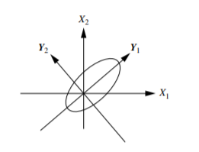
Principal Components Analysis
Principal components analysis (PCA; also called as K-L, method) searches for k n-dimensional orthogonal vectors that can best be used to represent the data, where k ≤ n. The original data are thus projected onto a much smaller space, resulting in dimensionality reduction

Slide 81
Principal Components Analysis
The basic procedure is as follows:
1. The input data are normalized, so that each attribute falls within the same range. This step helps ensure that attributes with large domains will not dominate attributes with smaller domains.
2. PCA computes k orthonormal vectors that provide a basis for the normalized input data. These are unit vectors that each point in a direction perpendicular to the others. These vectors are referred to as the principal components. The input data are a linear combination of the principal components.

Slide 82
Principal Components Analysis
3.The principal components are sorted in order of decreasing “significance” or strength. The principal components essentially serve as a new set of axes for the data, providing important information about variance. That is, the sorted axes are such that the first axis shows the most variance among the data, the second axis shows the next highest variance, and so on.
For example, the above Figure shows the first two principal components, Y₁ and Y₂, for the given set of data originally mapped to the axes X₁ and X₂. This information helps identify groups or patterns within the data.
4. Because the components are sorted in decreasing order of “significance,” the data size can be reduced by eliminating the weaker components, that is, those with low variance. Using the strongest principal components, it should be possible to reconstruct a good approximation of the original data.

Slide 83
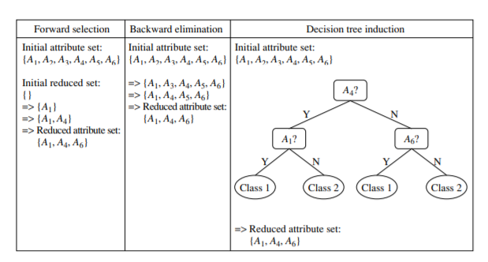
Attribute Subset Selection
Attribute subset selection reduces the data set size by removing irrelevant or redundant attributes (or dimensions).
The goal of attribute subset selection is to find a minimum set of attributes such that the resulting probability distribution of the data classes is as close as possible to the original distribution obtained using all attributes.

Slide 84
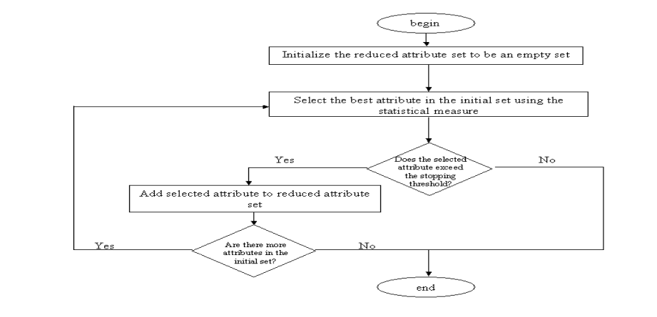
Example
Use a flowchart to summarize the following procedures for attribute subset selection: (a) stepwise forward selection (b) stepwise backward elimination (c) a combination of forward selection and backward elimination
stepwise forward selection

Slide 85
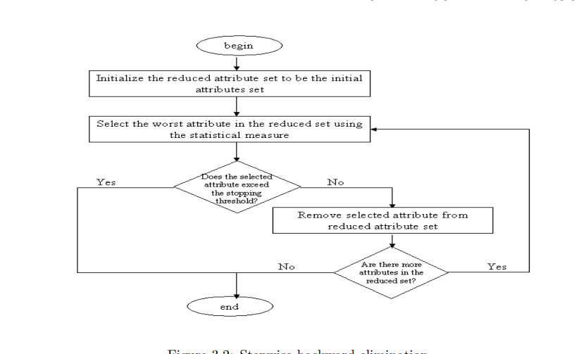
Example
stepwise backward elimination

Slide 86
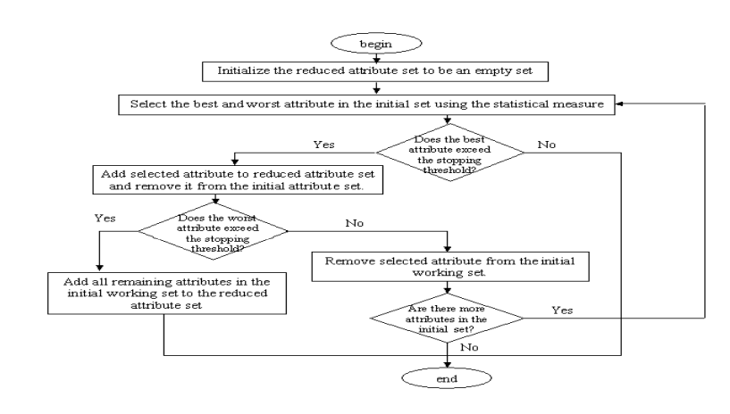
Example
c).a combination of forward selection and backward elimination

Slide 87
Attribute Subset Selection
1.Stepwise forward selection: The procedure starts with an empty set of attributes as the reduced set. The best of the original attributes is determined and added to the reduced set. At each subsequent iteration or step, the best of the remaining original attributes is added to the set.
2.Stepwise backward elimination: The procedure starts with the full set of attributes. At each step, it removes the worst attribute remaining in the set.
3.Combination of forward selection and backward elimination: The stepwise forward selection and backward elimination methods can be combined so that, at each step, the procedure selects the best attribute and removes the worst from among the remaining attributes.

Slide 88
Attribute Subset Selection
4. Decision tree induction: Decision tree algorithms (e.g., ID3, C4.5, and CART) were originally intended for classification.
Decision tree induction constructs a flowchartlike structure where each internal (nonleaf) node denotes a test on an attribute, each branch corresponds to an outcome of the test, and each external (leaf) node denotes a class prediction.
At each node, the algorithm chooses the “best” attribute to partition the data into individual classes.

Slide 89
Regression and Log-Linear Models: Parametric Data Reduction
Regression and log-linear models can be used to approximate the given data. In linear regression, the data are modeled to fit a straight line. For example, a random variable, y (called a response variable), can be modeled as a linear function of another random variable, x (called a predictor variable), with the equation.
where the variance of y is assumed to be constant. In the context of data mining, x and y are numeric database attributes. The coefficients, w and b (called regression coefficients), specify the slope of the line and the y-intercept.

Slide 90
Regression and Log-Linear Models: Parametric Data Reduction
Multiple linear regression is an extension of (simple) linear regression, which allows a response variable, y, to be modeled as a linear function of two or more predictor variables.
Log-linear models approximate discrete multidimensional probability distributions. Given a set of tuples in n dimensions , consider each tuple as a point in an n-dimensional space. Log-linear models can be used to estimate the probability of each point in a multidimensional space for a set of discretized attributes, based on a smaller subset of dimensional combinations.

Slide 91
Regression and Log-Linear Models: Parametric Data Reduction
Histograms
Histograms use binning to approximate data distributions and are a popular form of data reduction.
A histogram for an attribute, A, partitions the data distribution of A into disjoint subsets, referred to as buckets or bins. If each bucket represents only a single attribute–value/frequency pair, the buckets are called singleton buckets
Example:
Histograms. The following data are a list of AllElectronics prices for commonly sold items (rounded to the nearest dollar). The numbers have been sorted: 1, 1, 5, 5, 5, 5, 5, 8, 8, 10, 10, 10, 10, 12, 14, 14, 14, 15, 15, 15, 15, 15, 15, 18, 18, 18, 18, 18, 18, 18, 18, 20, 20, 20, 20, 20, 20, 20, 21, 21, 21, 21, 25, 25, 25, 25, 25, 28, 28, 30, 30, 30.

Slide 92
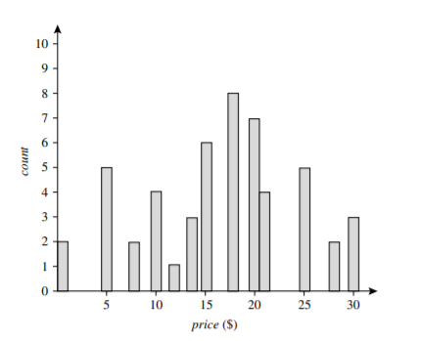
Example
Fig:1 A histogram for price using singleton buckets—each bucket represents one price–value/ frequency pair

Slide 93
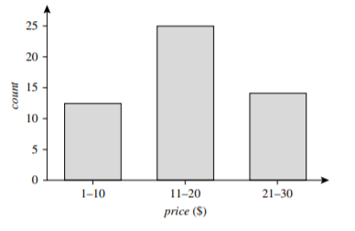
Example
Fig:2 An equal-width histogram for price, where values are aggregated so that each bucket has a uniform width of $10

Slide 94
Example
Suppose a group of 12 sales price records has been sorted as follows: 5, 10, 11, 13, 15, 35, 50, 55, 72, 92, 204, 215. Partition them into three bins by each of the following methods. (a) equal-frequency (equidepth) partitioning (b) equal-width partitioning (c) clustering
Answer:
(a) equal-frequency (equidepth) partitioning Partition the data into equidepth bins of depth 4: Bin 1: 1: 5, 10, 11, 13 Bin 2: 15, 35, 50, 55 Bin 3: 72, 92, 204, 215
(b) equal-width partitioning Partitioning the data into 3 equi-width bins will require the width to be (215 − 5)/3 = 70. We get: Bin 1: 5, 10, 11, 13, 15, 35, 50, 55, 72 Bin 2: 92 Bin 3: 204, 215
(c) clustering Using K-means clustering to partition the data into three bins we get: Bin 1: 5, 10, 11, 13, 15, 35 Bin 2: 50, 55, 72, 92 Bin 3: 204, 215

Slide 95
Regression and Log-Linear Models: Parametric Data Reduction
There are several partitioning rules, including the following:
Equal-width: In an equal-width histogram, the width of each bucket range is uniform (e.g., the width of $10 for the buckets in Figure 2).
Equal-frequency (or equal-depth): In an equal-frequency histogram, the buckets are created so that, roughly, the frequency of each bucket is constant (i.e., each bucket contains roughly the same number of contiguous data samples).
Clustering
Clustering techniques consider data tuples as objects.Centroid distance is an alternative measure of cluster quality and is defined as the average distance of each cluster object from the cluster centroid (denoting the “average object,” or average point in space for the cluster).

Slide 96
Sampling
Sampling can be used as a data reduction technique because it allows a large data set to be represented by a much smaller random data sample (or subset). Suppose that a large data set, D, contains N tuples. Let’s look at the most common ways that we could sample D for data reduction,
Simple random sample without replacement (SRSWOR) of size s: This is created by drawing s of the N tuples from D (s < N), where the probability of drawing any tuple in D is 1/N, that is, all tuples are equally likely to be sampled.
Simple random sample with replacement (SRSWR) of size s: This is similar to SRSWOR, except that each time a tuple is drawn from D, it is recorded and then replaced. That is, after a tuple is drawn, it is placed back in D so that it may be drawn again.
Cluster sample: If the tuples in D are grouped into M mutually disjoint “clusters,” then an SRS of s clusters can be obtained, where s < M.
Stratified sample: If D is divided into mutually disjoint parts called strata, a stratified sample of D is generated by obtaining an SRS at each stratum. This helps ensure a representative sample, especially when the data are skewed.

Slide 97
Data Transformation and Data Discretization
In data transformation, the data are transformed or consolidated into forms appropriate for mining. Strategies for data transformation include the following:
1. Smoothing, which works to remove noise from the data. Techniques include binning, regression, and clustering.
2. Attribute construction (or feature construction), where new attributes are constructed and added from the given set of attributes to help the mining process.
3. Aggregation, where summary or aggregation operations are applied to the data
4. Normalization, where the attribute data are scaled so as to fall within a smaller range, such as −1.0 to 1.0, or 0.0 to 1.0.
5. Discretization, where the raw values of a numeric attribute (e.g., age) are replaced by interval labels (e.g., 0–10, 11–20, etc.) or conceptual labels (e.g., youth, adult, senior).
6. Concept hierarchy generation for nominal data, where attributes such as street can be generalized to higher-level concepts, like city or country.

Slide 98

DATA TRANSFORMATION BY NORMALIZATION
Data normalization methods are min-max normalization, z-score normalization, and normalization by decimal scaling.
let A be a numeric attribute with n observed values, v₁, v₂,..., v_{n}.
Min-max normalization performs a linear transformation on the original data. Suppose that minA and maxA are the minimum and maximum values of an attribute, A. Min-max normalization maps a value, v_{i} , of A to v_{i}¹ in the range [new minA,newmaxA] by computing

Slide 99
Example:
Min-max normalization. Suppose that the minimum and maximum values for the attribute income are $12,000 and $98,000, respectively. We would like to map income to the range [0.0,1.0]. By min-max normalization, a value of $73,600 for income is transformed to
v_{i}¹ = (73,600−12,000)/(98,000−12,000) (1.0 − 0) + 0 = 0.716.

Slide 100
Example:
for the attribute age: 13, 15, 16, 16, 19, 20, 20, 21, 22, 22, 25, 25, 25, 25, 30, 33, 33, 35, 35, 35, 35, 36, 40, 45, 46, 52, 70. Calculate the values for 15,20,35
Use min-max normalization to transform the value 13, 15, 16, 16, 19, 20, 20, 21, 22, 22, 25, 25, 25, 25, 30, 33, 33, 35, 35, 35, 35, 36, 40, 45, 46, 52, 70. for age onto the range [0.0,1.0].
For the value 15
min_{A}=13
max_{A}=70
newmin_{A}=0
newmax_{A}=1.0
v = 15
V_{i}¹ =(15-13)/(70-13)(1-0)+0
V_{i}¹ =0.04

Slide 101
Example:
For the value 20
min_{A}=13
max_{A}=70
newmin_{A}=0
newmax_{A}=1.0
v = 20
V_{i}¹ =(20-13)/(70-13)(1-0)+0
V_{i}¹ =0.12
For the value 35
min_{A}=13,
max_{A}=70,
newmin_{A}=0,
newmax_{A}=1.0,
v = 35
V_{i}¹ =(35-13)/(70-13)(1-0)+0
V_{i}¹ =0.39

Slide 102
Use the methods below to normalize the following group of data: 200, 300, 400, 600, 1000 (a) min-max normalization by setting min = 0 and max = 1 (b) z-score normalization (c) z-score normalization using the mean absolute deviation instead of standard deviation (d) normalization by decimal scaling

Slide 103


z-score normalization
z-score normalization (or zero-mean normalization), the values for an attribute, A, are normalized based on the mean (i.e., average) and standard deviation of A. A value, v_{i} , of A is normalized to v_{i}¹ by computing
σA
where A¯ and σA are the mean and standard deviation, respectively, of attribute A

Slide 104
Example:
z-score normalization. Suppose that the mean and standard deviation of the values for the attribute income are $54,000 and $16,000, respectively. With z-score normalization, a value of $73,600 for income is transformed to
V_{i} = 73,600
A¯= 54,000
σA= 16,000
v_{i}¹ = (73,600−54,000)/16,000 = 1.225.

Slide 105

Example:
z-score normalization for the following data
8,10,15,20
Mean=(8+10+15+20)/4
=53/4
=13.25
Standard deviationσA
= 4.6
= 4.6

Slide 106
Example:
For value 8
V_{i}¹= (8-13.25)/4.6
= -1.14
For value 10
V_{i}¹= (10-13.25)/4.6
=-0.7
For value 15
V_{i}¹= (15-13.25)/4.6
=0.3
For value 20
V_{i}¹= (20-13.25)/4.6
=1.4
data | data after z-score normalization
8 | -1.14
10 | -0.7
15 | 0.3
20 | 1.4

Slide 107

Normalization by decimal scaling
Normalization by decimal scaling normalizes by moving the decimal point of values of attribute A. The number of decimal points moved depends on the maximum absolute value of A. A value, v_{i} , of A is normalized to v_{i}¹by computing
where j is the smallest integer such that max(|v_{i}¹ |) < 1.

Slide 108
Example
for the attribute age: 13, 15, 16, 16, 19, 20, 20, 21, 22, 22, 25, 25, 25, 25, 30, 33, 33, 35, 35, 35, 35, 36, 40, 45, 46, 52, 70.
Use Normalization by decimal scaling to transform the value 35 for age
where j = 2, v = 35 is transformed to v′= 35/100=0.35
Use Normalization by decimal scaling to transform the value45for age
where j = 2, v = 45 is transformed to v′= 45/100=0.45

Slide 109
1.Use these methods to normalize the following group of data: 200,300,400,600,1000. Calculate for all values
(a) min-max normalization by setting min=0 and max=1
(b) z-score normalization
(c) normalization by decimal scaling
2. Use these methods to normalize the following group of data: 5, 10, 11, 13, 15, 35, 50, 55, 72, 92, 204, 215 .Calculate the values for 11, 92, 55, 215
(a) min-max normalization by setting min=0 and max=1
(b) z-score normalization
(c) normalization by decimal scaling

Slide 111
Discretization by Binning
Binning is a top-down splitting technique based on a specified number of bins.
These methods are also used as discretization methods for data reduction and concept hierarchy generation. n.
For example, attribute values can be discretized by applying equal-width or equal-frequency binning, and then replacing each bin value by the bin mean or median, as in smoothing by bin means or smoothing by bin medians, respectively.

Slide 112
Discretization by Histogram Analysis
A histogram partitions the values of an attribute, A, into disjoint ranges called buckets or bins.
In an equal-width histogram, for example, the values are partitioned into equal-size partitions or ranges.
With an equal-frequency histogram, the values are partitioned so that, ideally, each partition contains the same number of data tuples.
A minimum interval size can also be used per level to control the recursive procedure.

Slide 113
Discretization by Cluster, Decision Tree, and Correlation Analyses
Cluster analysis is a popular data discretization method. A clustering algorithm can be applied to discretize a numeric attribute, A, by partitioning the values of A into clusters or groups.
Decision tree–based discretization uses class information, it is more likely that the interval boundaries (split-points) are defined to occur in places that may help improve classification accuracy.
Measures of correlation can be used for discretization. Chi Merge is a χ 2 -based discretization method.

Slide 114
Concept Hierarchy Generation for Nominal Data
Specification of a partial ordering of attributes explicitly at the schema level by users or experts: Concept hierarchies for nominal attributes or dimensions typically involve a group of attributes.
Specification of a portion of a hierarchy by explicit data grouping: This is essentially the manual definition of a portion of a concept hierarchy. In a large database, it is unrealistic to define an entire concept hierarchy by explicit value enumeration.
Specification of a set of attributes, but not of their partial ordering: A user may specify a set of attributes forming a concept hierarchy, but omit to explicitly state their partial ordering.
Specification of only a partial set of attributes: Sometimes a user can be careless when defining a hierarchy, or have only a vague idea about what should be included in a hierarchy.

